Slide 1

Hospital Readmission Predictor
A Machine Learning Approach to Predict Patient Readmission Risk
: Dev Khakhar

Slide 2
Hospital Readmission Predictor
AI and ML are revolutionizing healthcare analytics.
Predictive modeling anticipates patient outcomes, such as readmission.
This POC focuses on predicting hospital readmissions to improve care and reduce costs.
Hospital readmissions are costly and often preventable. Accurately predicting which patients are at risk of readmission can help healthcare providers allocate resources more effectively and improve patient outcomes.

Slide 3
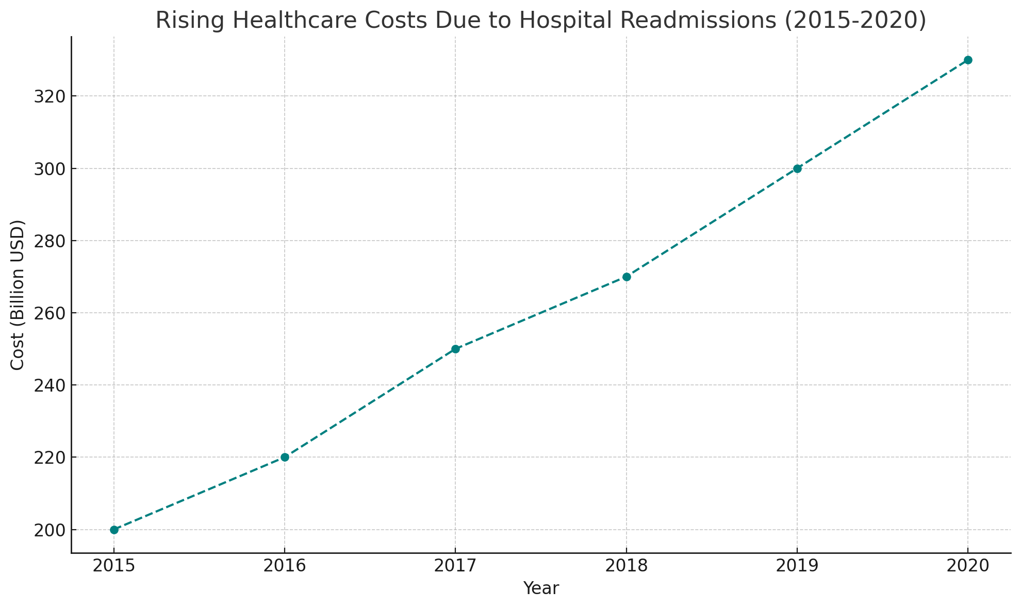
Impact of Hospital Readmissions on Healthcare Costs

Slide 4
What is Predictive Modeling ?
Predictive modeling uses statistical techniques and ML to predict future outcomes
In healthcare, it helps anticipate events like patient readmissions
Enables proactive decision-making to enhance patient care.

Slide 5
Trends in Predictive Modeling
Predictive analytics to forecast patient outcomes.
Integration with Electronic Health Records (EHRs) for real-time support.
Time-series analysis and anomaly detection for monitoring health metrics.
AI-driven personalized medicine

Slide 6
Opportunities in Predictive Modeling
Enhanced patient care through early risk identification.
Optimized resource allocation and operational efficiency.
Cost savings by reducing readmission rates.
Empowers data-driven clinical decision-making.

Slide 7
Challenges and Threats
Data quality issues can lead to inaccurate predictions.
Complex models may lack interpretability, leading to trust issues.
Ethical concerns, including patient privacy and bias.
Integration with existing clinical workflows can be challenging.

Slide 8
Strategic Recommendations
Invest in interpretable models to build trust with clinicians.
Ensure seamless integration with EHRs and other healthcare systems.
Prioritize data quality for accurate and reliable predictions.
Promote ethical AI practices, focusing on transparency and fairness.
Provide training and support for healthcare providers.

Slide 9
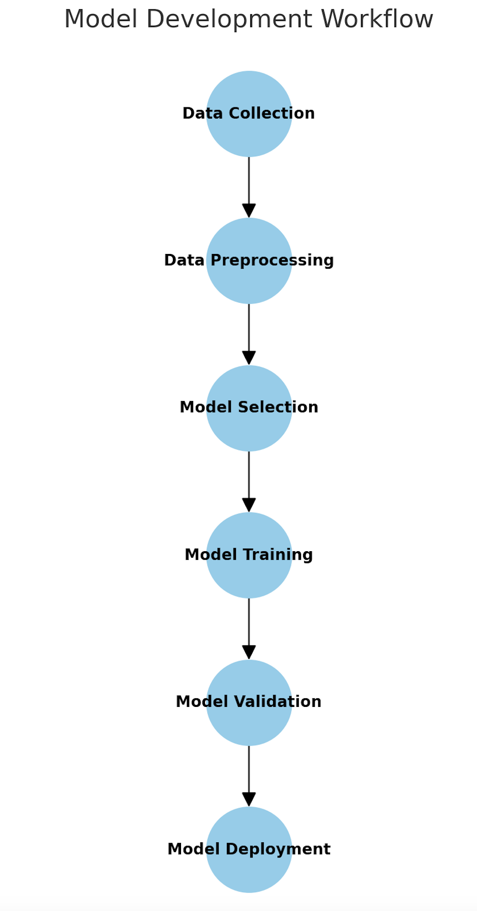
Model Development
Model Chosen: "Logistic Regression”
Logistic Regression was chosen due to its interpretability and effectiveness in binary classification tasks like predicting readmission likelihood.
The model was trained on historical hospital readmission data, with a focus on accuracy and minimizing false positives.

Slide 10
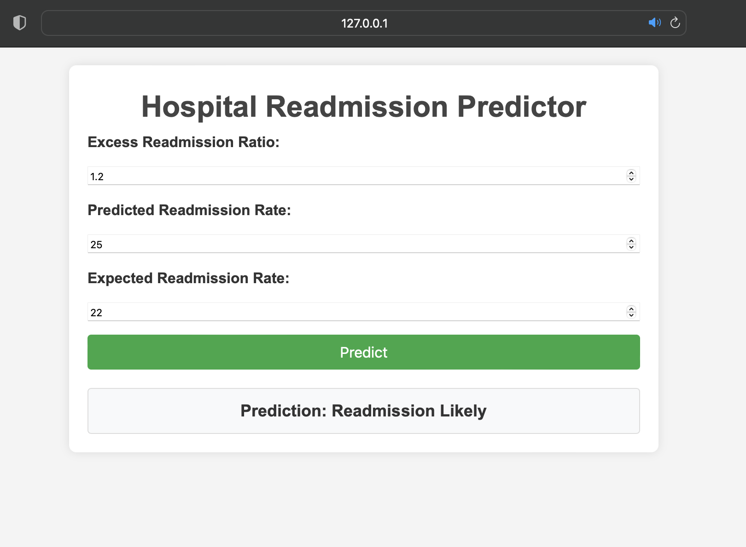
Web Application
The web application allows users to input values for Excess Readmission Ratio, Predicted Readmission Rate, and Expected Readmission Rate to receive a prediction on readmission likelihood.

Slide 11
Results
The Logistic Regression model developed for predicting hospital readmissions achieved an overall accuracy of 75%. This means that 75% of the time, the model correctly predicted whether a patient would be readmitted based on their input data.
The model demonstrated a precision of 87% when predicting cases where readmission was likely. Precision is important in this context as it indicates the proportion of true positive predictions (correctly identified readmissions) among all positive predictions (both true positives and false positives). A high precision reduces the risk of falsely identifying patients as high-risk for readmission.

Slide 12
Future Work
Explore more complex models like Random Forest or XGBoost to improve prediction accuracy
Add user authentication to allow users to save and view past predictions.
Deploy the application online for public access by healthcare professionals.

Slide 13
Conclusion
This project demonstrates the potential of machine learning in predicting hospital readmissions. The web application provides a user-friendly interface for healthcare providers to assess patient readmission risk.
Accurate predictions can help reduce readmission rates, lower healthcare costs, and improve patient outcomes.
Predictive modeling is a powerful tool for improving healthcare outcomes.
Accurate readmission predictions can reduce costs and improve care.

